Slide 1
Emergency Services Enterprise Framework: A Service-Oriented Approach
Sukumar Dwarkanath
COMCARE
Michael Daconta
Oberon Associates
24 May 2006

Slide 2
Roadmap
Definitions - context
Framework
  4 components
Use Case
Benefits
Conclusion

Slide 3




















COMCARE Overview
A national advocacy organization of over 100 organizations dedicated to advancing emergency communications

Slide 4
Emergency Services
What do we mean by Emergency Services?
  It is the set of agencies that are involved in emergency preparedness, planning, response and recovery functions.
  Diverse set of entities – from public safety to private industry

Slide 5
Emergency Services Enterprise
Stakeholders
  Traditional first responder agencies
  Public health
  Hospitals
  Transportation
  Emergency Management
  Federal, state and local government agencies
  Private sector organizations
  Media, and others
Characteristics
  Diverse
  Varied needs and requirements
  No single entity – in charge

Slide 6
Community of Interest (COI)
a collaborative group of users/stakeholders with a common business objective and mission
Helps to provide a shared perspective

Slide 7
Service Oriented Architecture (SOA)
An architectural approach and methodology
Concept of services - aligned with business process and enabled by technology
Characteristics
  Open architecture and standards-based
  Modular and scalable
  Flexible
Structure
  Well suited to serve the emergency services enterprise

Slide 8
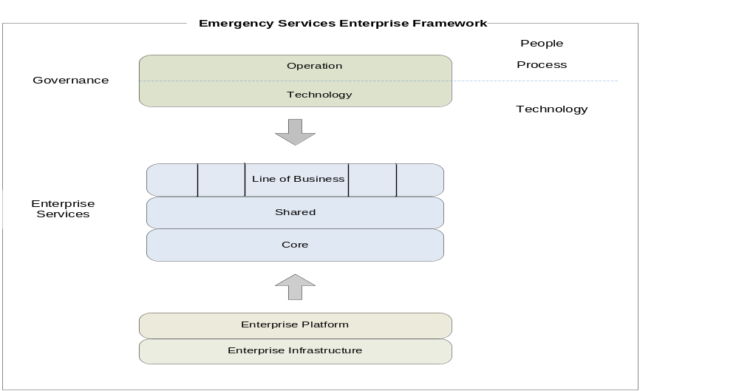

Emergency Services Enterprise: A Framework

Slide 9
Governance
Governs the Emergency Services Enterprise
High-level set of policies and procedures
Two components:
  Operational
  Technology

Slide 10
Enterprise Services
Core Services
  Across the enterprise
Shared Services
  Subset of enterprise
Line Of Business (LOB) Services
  Vertical, intra-domain
Differentiator – Business case

Slide 11
Line Of Business (LOB) Services
Vertical, domain-specific business services
Provided by a single domain
For example:
  Hazardous Materials (HAZMAT) identification service - Emergency Management domain.
  A traffic advisory LOB services - the regional domain.

Slide 12
Shared Services
Shared among domains
May be offered as competitive services
May be specific to a region, city or any other subset of the larger COI
For Example:
  Hospital Bed Availability Service - shared between hospitals, EMS, and Emergency Management.

Slide 13
Core Services
Common shared utility for the emergency enterprise.
Facilitation capabilities
Governed by the entire emergency services COI.
For Example:
  Identity and Access Management
  Data Rights Management

Slide 14
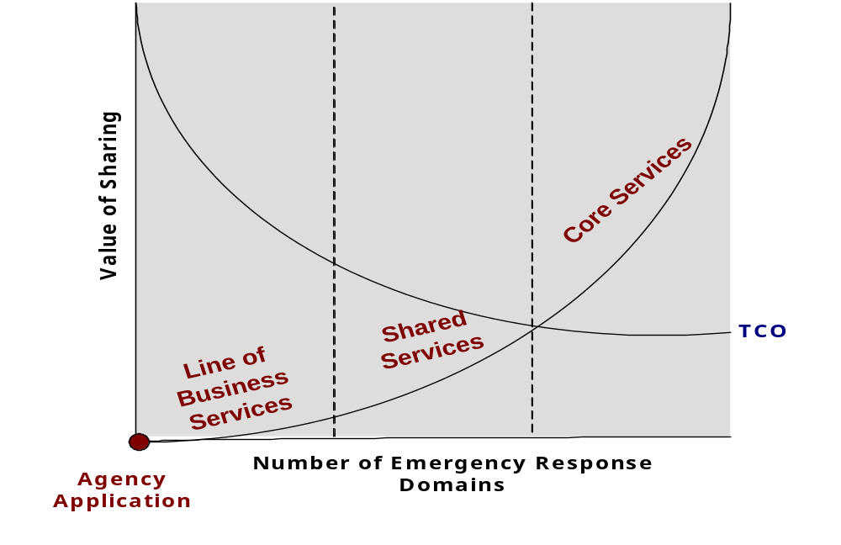
Enterprise Services TCO

Slide 15
Enterprise Platform
Methods and tools
Applications
Includes the various sets of integration technologies, systems and standards that are used by the entities in the enterprise
  Data and Messaging standards
  Data Models
  Integration Services
Enable the Services layer
Notes:
Methods and tools – enable the Enterprise Services

Slide 16
Enterprise Infrastructure
Network and Transport modules
  the access and delivery channels
  Various transport modes like terrestrial and satellite communications, including wired and wireless
Critical Factors
  Redundancy
  Reliability
  Availability
Hurricane Katrina

Slide 17
Applying the Framework: Use Case
Scenario Description
  A major terrorist attack has occurred in a downtown area, and a mass disaster has been declared, given the scope and nature of the attack.
  The local emergency management agency (EMA) needs resources, and needs to collaborate with other agencies and share information.

Slide 18
Use Case - continued
Enterprise Services
  Core Service - the entity locator service - to look up authorized emergency responder agencies in the area, alerts these agencies of the disaster.
  Shared and LOB Services - Response units are dispatched and they use a number of the above services to respond efficiently. Some examples include:
    The Department of Transportation’s Traffic Advisory Service provides the best and alternate route information
    The Weather Information and Discovery Service allows the response units to get the current and predicted weather information
    The Intelligence and Information Analysis Service provides a detailed analysis of nearby schools, critical infrastructure etc., which enables decision support applications to provide simulations

Slide 19
Use Case - continued
Governance
Platform
Infrastructure
  Established governance structure - uniform policy and procedure on collaboration and information exchange
  Agencies use established data standards and exchange packages to disseminate information
  The service delivery and access channels have redundant wired, wireless, and satellite communications links to ensure available links

Slide 20
Service-oriented Enterprise Adoption: Benefits
Collaborative platform
Ease of integration and information-sharing
Re-use of services
Means to discover and access the various sources of data and information
A scalable and flexible multilateral solution
In summary, the envisioned architecture improves efficiency, streamlines effectiveness, and enhances enterprise-wide operations.

Slide 21
Conclusion
Emergency Services community – diverse
The need - a comprehensive logical framework
Envisioned Emergency Services Framework
  Emergency Services COI
  Service-oriented approach
  Safety as an overall enterprise

Slide 22
Questions?
Sukumar Dwarkanath
Technical Director
COMCARE
sdwarkanath@comcare.org
202-429-0574

